Slide 1
hExSCAPE
From Down2 Developers
Release Review

Slide 2
Sprint 7 Scrum Roles
Scrum Master: Dane Reggia
Product Owner: Billy Loveday
Development Team: Michael Ouille
Gabriel Mayo

Slide 3
Dane’s Sprint Goals
Spawn enemies in a distinguishing color(3)
Give them movement similar to player’s army(3)
Planning to invest 6 hours toward these goals

Slide 4
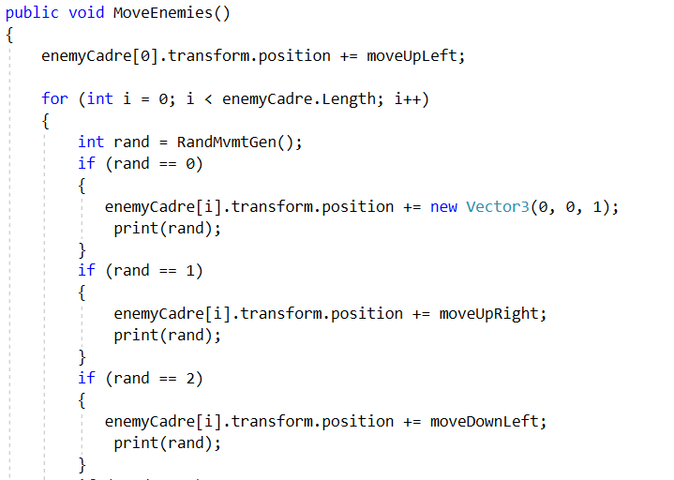
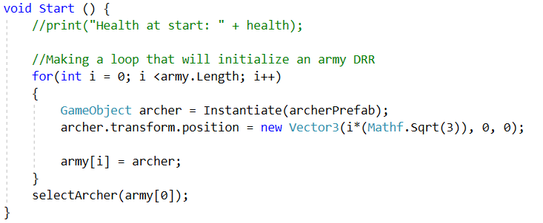
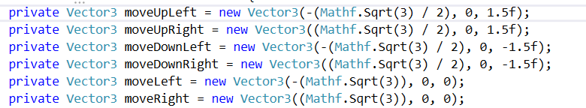
Dane’s Sprint Accomplishments
Successfully spawning enemies randomly on the board, not on top of plater army.
Unsuccessful in achieving movement
* 7 hours of work

Slide 5
Michael’s Goals/Accomplishments
This sprint, my task was to clean up the HUD assets and to write a script that allows public access to each HUD object.
Committed 5 hours to this sprint.
Accomplished all 5 hours of work on the sprint goals.
I successfully cleaned up the HUD assets and I wrote/tested the script.

Slide 6
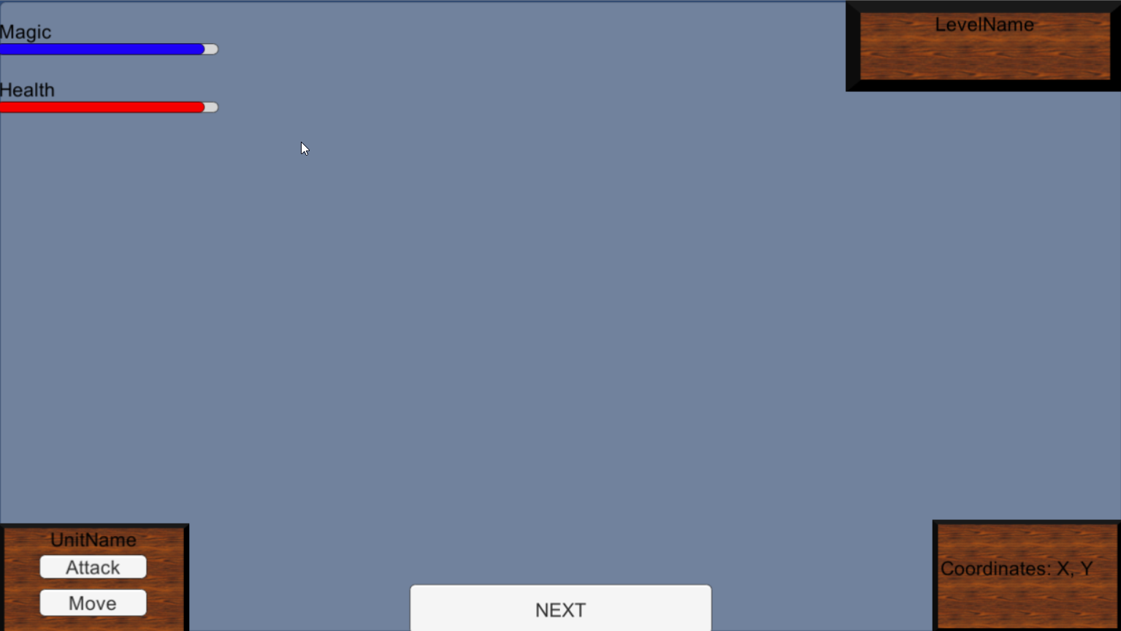
In-Game HUD Display

Slide 7
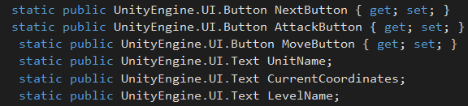
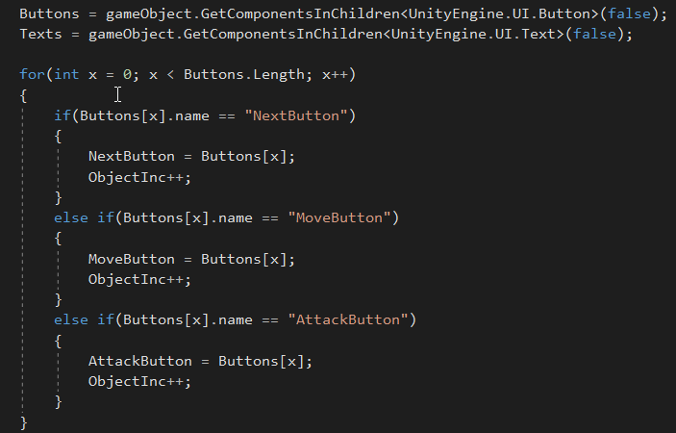
HUD Code

Slide 8
Gabe’s Sprint Goals/Accomplishments
My goal for this sprint was to implement attack logic, including target selection.
I committed about 5 hours to this task.
Results:
I worked about 7 hours this week on this task.
The event system is complicated and took up far too much of my work time to figure out. And I still don’t know if I did it right!

Slide 9
Billy’s Bucket List
Create more 3D models
Critical: customer requested a basket
Unify Unity project
Post Sprint 7
Ensure intro video plays
Ensure all assets and scripts are operational
Compile into an executable

Slide 10
Billy's Accomplishments
Create more 3D models
Unification – everything is finally in one project (hopefully)
Unification happened late in the sprint
Roadblock of CSC309

Slide 11
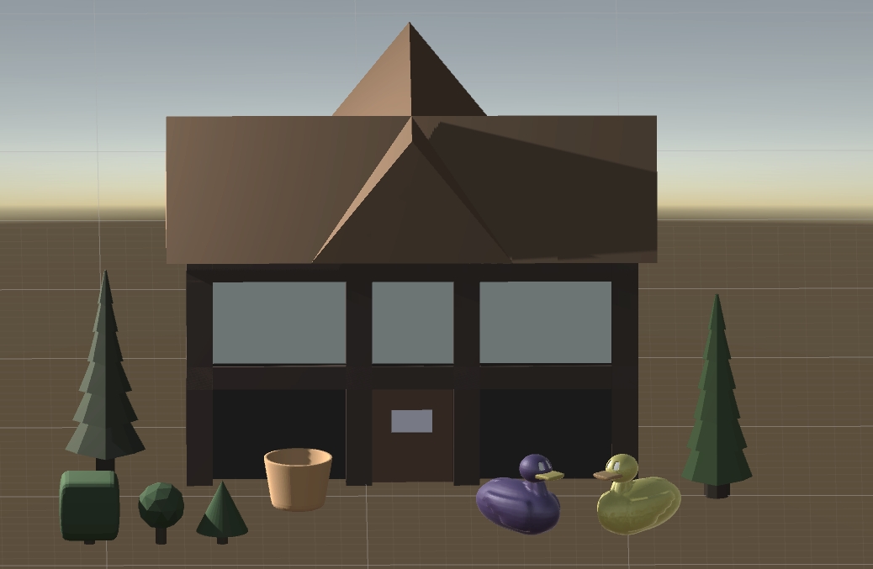

Slide 12
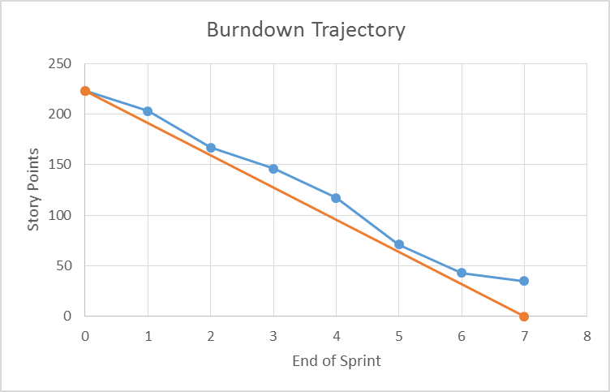
Burndown

Slide 13
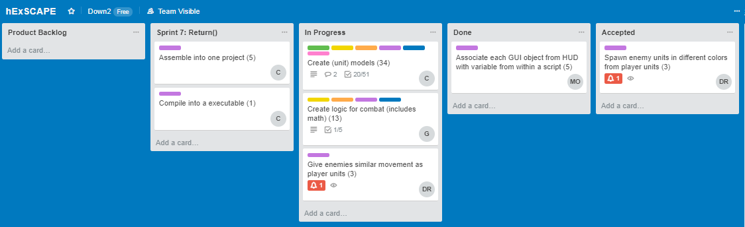
Current Snapshot of Backlog

